Slide 1
Bishopric and YW Presidency Training

Slide 2
Children and Youth Emblems of Achievement
Children and Youth striving to become more like Jesus Christ
To represent that unity, children and youth will receive several emblems during their time in Primary, Aaronic Priesthood quorums, and Young Women Classes

Slide 3
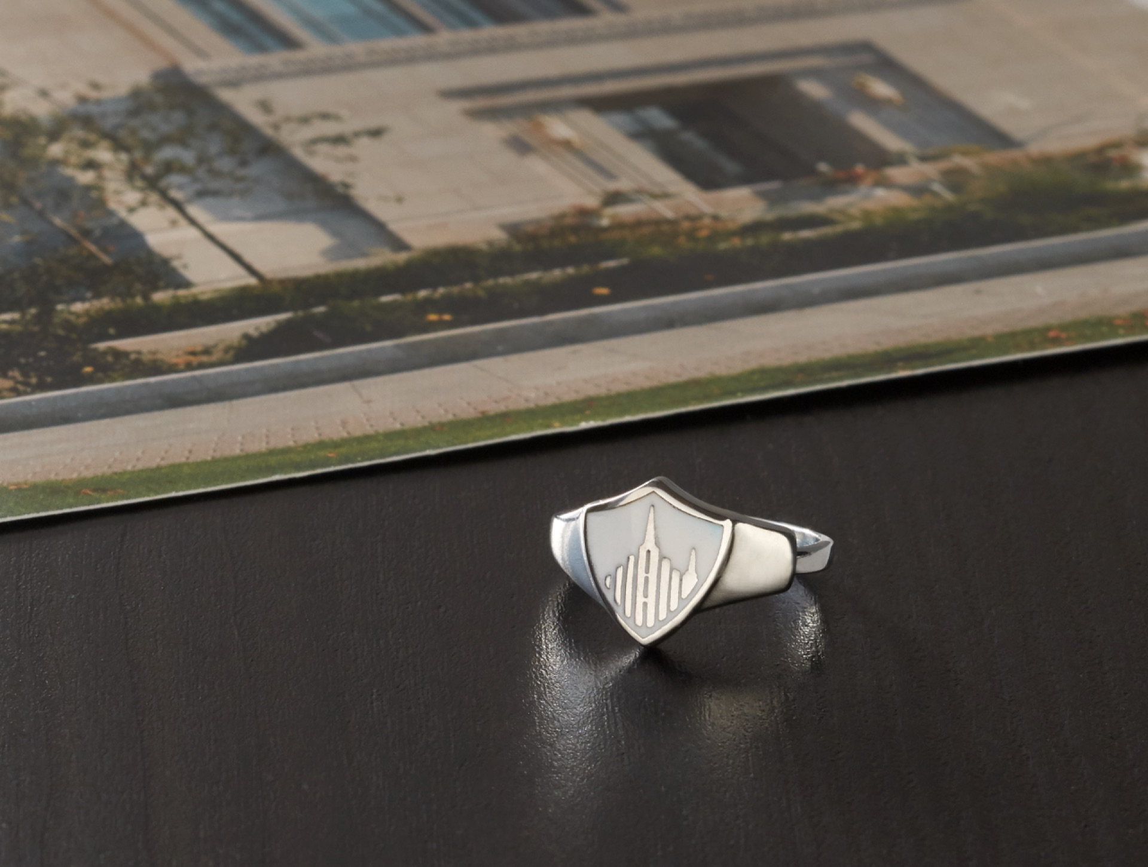
The year they turn 8
A ring
Picture of the temple in their temple district
Given to children by the Bishop

Slide 4
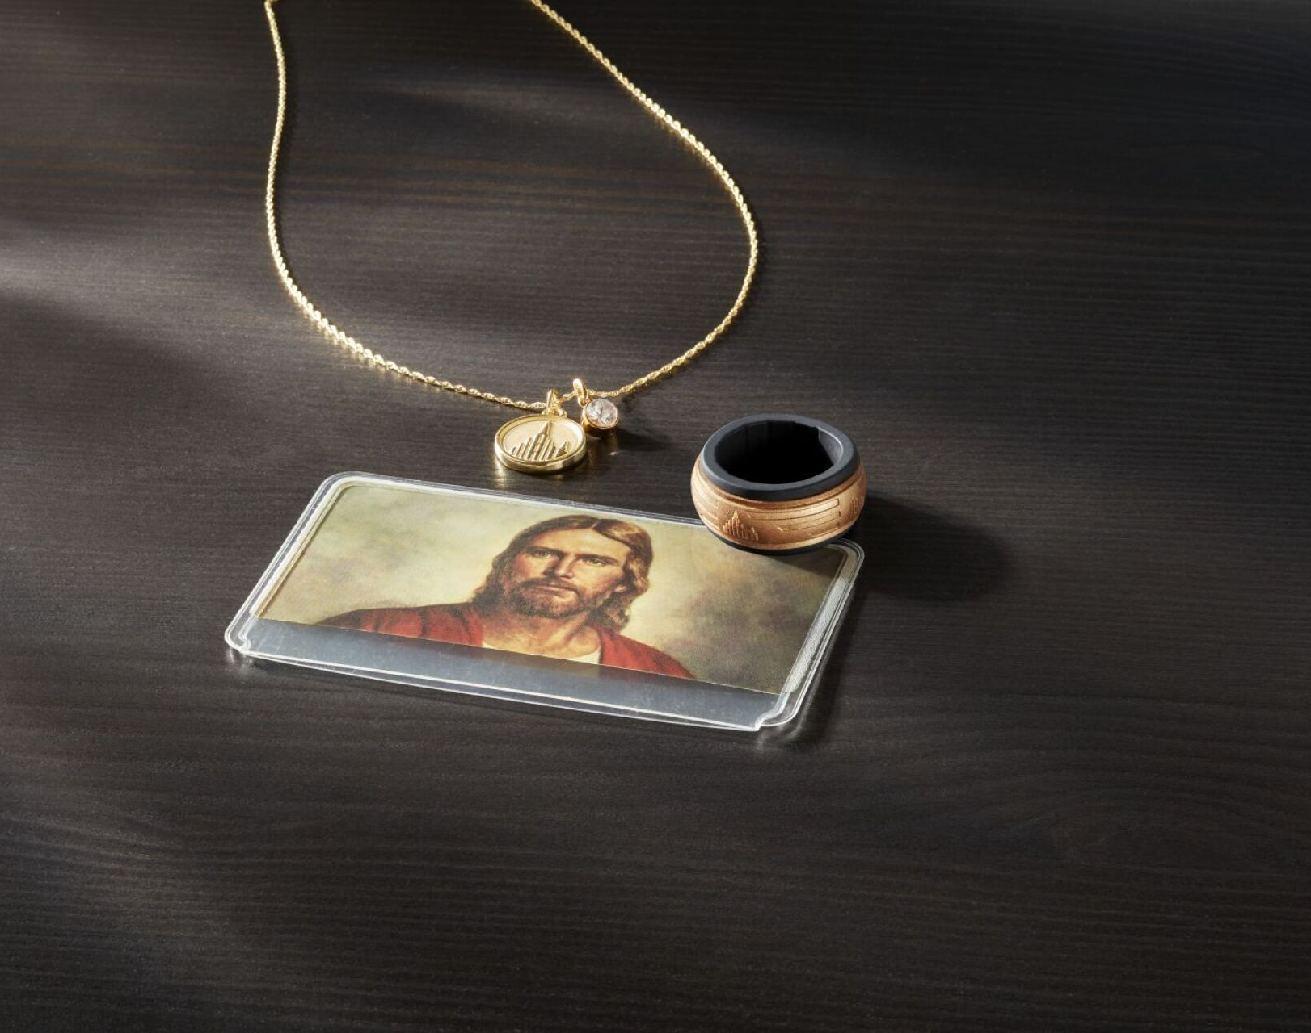
The year they turn 12
A temple recommend holder
YM – receive a ring
YW – receive a medallion and gem pendant
The ring and medallion/gem pendant will be given to them by their Quorum/Class Presidency
During an interview, the Bishop will give each youth a holder for the Temple Recommend.

Slide 5

The year they turn 18
YM – receive an oil vial
YW – receive a pendant
Oil vial or pendant will be given to youth by their quorum or class presidency near the beginning of the year they turn 18.

Slide 6
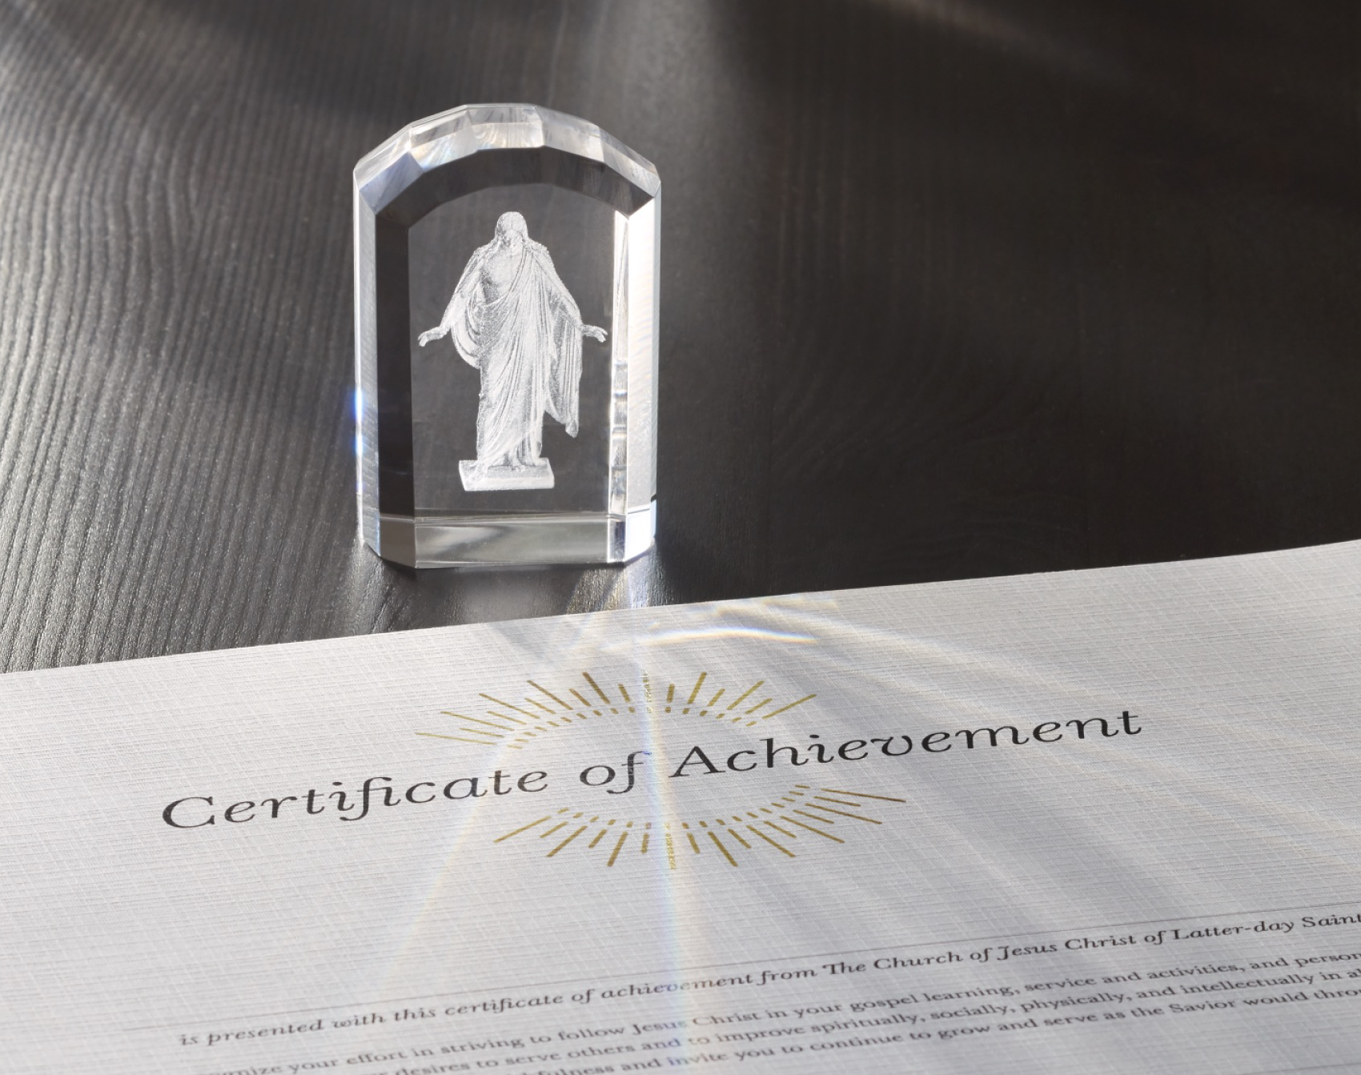
During the year the YM/YW turns 18
- 18yo Youth will have the opportunity to meet with the bishop(with parents present, if desired)
The Bishop will present a certificate from the First Presidency, as well as the Children and Youth Crystal
These emblems of achievement are given to youth who are trying to become more like the Savior by striving to:
  Study the scriptures and pray daily.
  Be worthy of a limited-use temple recommend
  Participate in Sabbath meetings, quorum and class work, and seminary
  Work on goals in each area of growth.
  Serve others in a personally significant way, which could include a service project.

Slide 7
New converts/Less Actives/Non-members
May also receive the emblems of achievement the year they turn 18 if, at the time of their interview, there are actively working to develop these patterns of discipleship.

Slide 8

Symbols for Strive to Be are available for local events and activities.

Slide 9
Motto

Slide 10
The Motto: “Strive to Be” is used to support children and youth to become more like the Savior.
The symbols: are a declaration of personal action and commitment and suggest long-term goals
The Purpose: is “Becoming: – a mindset of growth, the process of coming unto Christ, and being a part of God’s work.
This motto is to be a long-term sentiment, an overarching message, NOT to replace the varying annual themes, but work alongside as a constant aspiration

Slide 11
A message of hope that encourages us to:
Try hard
Make an effort
Do your best
Keep trying
Do not give up
Move forward with faith
Learn from mistakes or failures
Repent and improve

Slide 12
Luke 13:24
“Strive to enter in at the strait gait”

Slide 13
Philippians 1:27
“Stand fast in one spirit, with one mind striving together for the faith of the gospel”

Slide 14
1 Nephi 17:15
“ I, Nephi, did strive to keep the commandments of the Lord”

Slide 15
Helaman 15:6
“They are striving with unwearied diligence that they may bring the remainder of their brethren to the knowledge of the truth”

Slide 16
The effort to strive
Is to commit to follow the covenant path of baptism, receiving the gift of the Holy Ghost, priesthood covenants, temple endowment, temple marriage, and enduring to the end.

Slide 17
The symbols are reminders
To aim for the covenant path
To unite in belonging together
To support one another in our progression
In the temple interview, we are repeatedly asked
  “Do you strive…”
This phrase is to help us understand where our heart is in our efforts and encourage us to repent and grow.

Slide 18
Emblems of Belonging and Achievement
As children and youth strive to become more like Jesus Christ, they are unified by these emblems during their time in Primary, Aaronic Priesthood quorums, Young Women classes, and young adulthood.
These emblems ARE NOT awards to be earned, but a commitment(emblems of belonging) or commemoration(emblems of acheivement) of progression toward being faithful followers and disciples of Jesus Christ.

Slide 19
Links
https://www.churchofjesuschrist.org/bc/content/ldsorg/content/pdf/children-and-youth/2022/PD80002291-000-CY-Strive-StyleGuide.pdf
https://media.ldscdn.org/strive-to-be/strive-to-be-assets-eng.zip
https://permissions.churchofjesuschrist.org/

Slide 20
Luke 2:52
“Jesus increased in wisdom and stature, and in favor with God and man.”
  He grew – intellectually, physically, spiritually and socially
Striving to grow in a variety of areas in our life supports healthy emotional and mental wellness.
Growth and eternal potential are themes of the Restored Gospel of Jesus Christ.
OUR POTENTIAL to become like Heavenly Father is central to the gospel and helps us feel love, hope and gratitude.

Slide 21
President Dallin H. Oaks, First Counselor in the First Presidency, taught: “The Final Judgment is not just an evaluation of a sum total of good and evil acts—what we have done. It is an acknowledgment of the final effect of our acts and thoughts—what we have become. It is not enough for anyone just to go through the motions. The commandments, ordinances, and covenants of the gospel are not a list of deposits required to be made in some heavenly account. The gospel of Jesus Christ is a plan that shows us how to become what our Heavenly Father desires us to become.”³

